Slide 1
Predicting State and Local Taxes based on Economy and Bureaucracy
by: DJ Cumberbatch and Graham I. Gordon

Slide 2
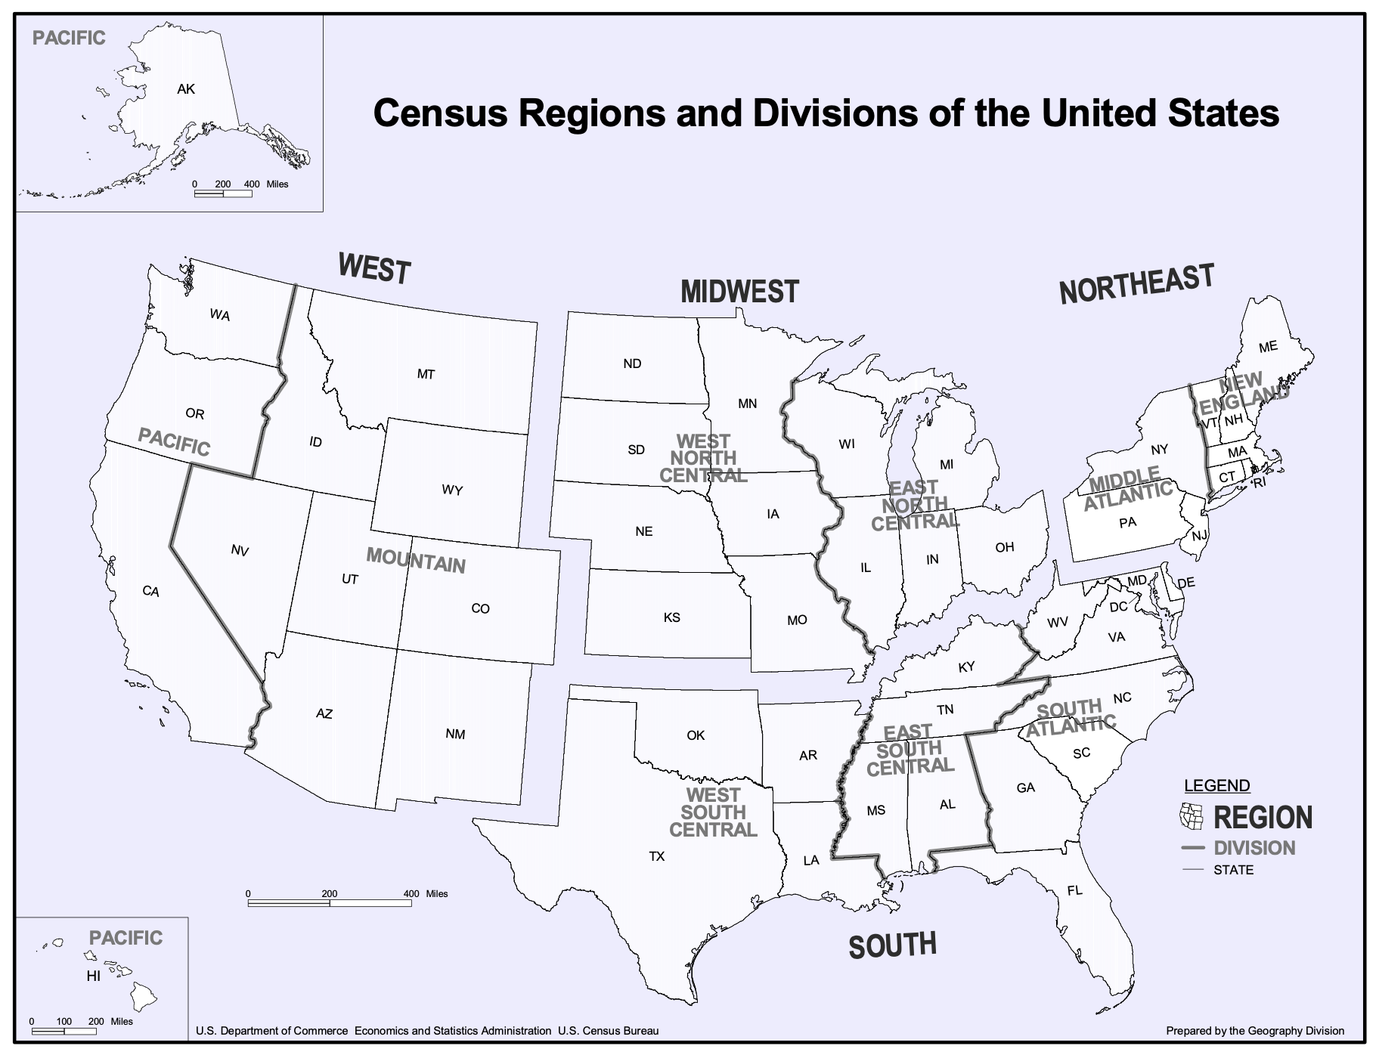
Methods and Variables
We are predicting state and local tax per state per capita using the characteristics of a state:
Census Bureau
Unemployed People
Insured People
Government Workers
Population
Territorial Region in the U.S.
IRS
State GDP
Tax Forms Filled in a State

Slide 3
Why is it necessary?
Consistency in tax usage
Measure of quality of life
Finds the best region to live at in the US for taxes purposes
Have all the states at a equal playing ground
(Importance of this model)

Slide 4
Results

Slide 5
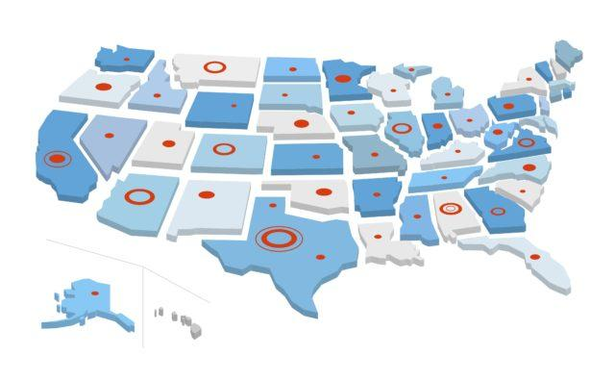
Average State
From the South
$5426 in gross state tax per person
For every 10000 people in a state there are 7718 tax forms filled
0.0517 dollars in GDP per person in the state
For every 100 people in a state 27 people are unemployed
91% of people are insured
7% are federal workers

Slide 6
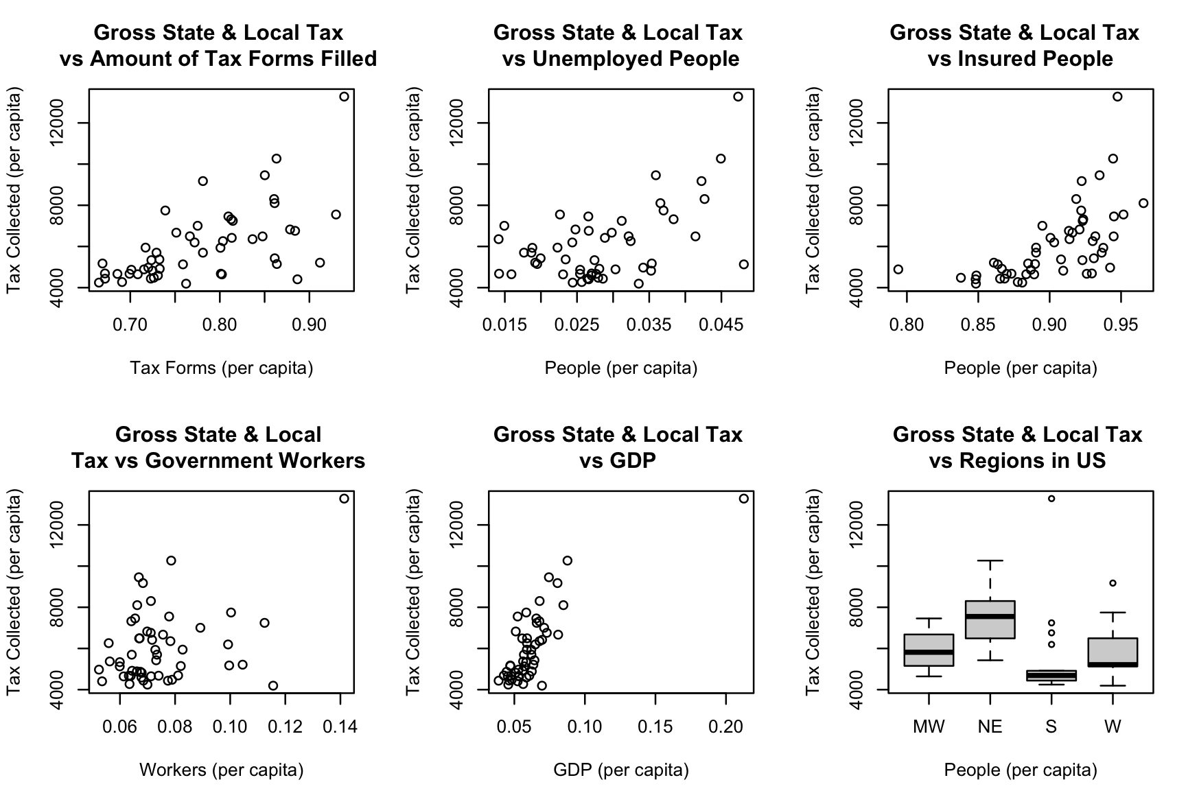
Plots of gross state and local tax vs predictors (per capita)
Tested multicollinearity and for outliers (D.C.).
0.005 <r < 0.55
VIF μ = 1.64

Slide 7
Linear Modeling

Slide 8
T = 0 + 3051f + 41652u + 14652i + 8774w + 37180g - 13704R(MW) + 13214R(NE) - 13963R(S) - 13736R(W)
Full Linear Model
T gross state and local tax per capita
f the number of forms filed per capita
u the number of unemployed persons
i the number of people with insurance per capita
w the number of government workers
g gross gdp of this state
R(x) indicator function equaling 1,
and where x is one of four regions: the Northeast (NE),
the South (S), the West (W) , or the Midwest (MW)

Slide 9
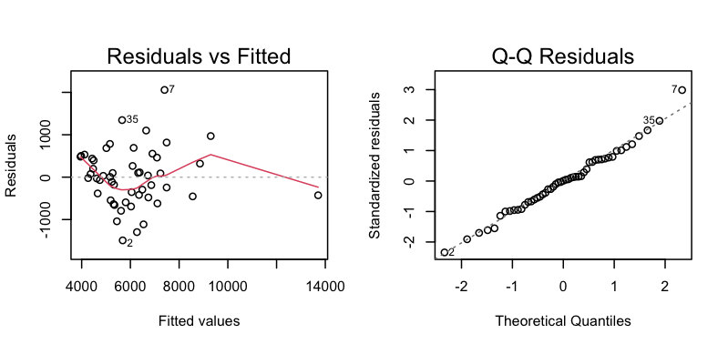
Stats and Diagnostics
R^2 = 0.8427
VIFs below 2.0
Matrix correlation well below .8
p-value was 0.313077
Government Worker Example:
t-value to be 1.021
df = 24
α-level = 10%

Slide 10
T = -15749 +40358u +19875i +43510g
Reduced Linear Model
Statistically Significant:
u the number of unemployed persons
i the number of people with insurance per capita
g gross gdp of this state
Statistically Insignificant (Removed):
w the number of government workers
f the number of forms filed per capita
R(x) indicator function equaling 1
F-tests with: α-level = 5%
H_0: No difference between full and reduced model
H_a: There is a difference
p = 0.07
5 dfs
F = 2.1738

Slide 11
Confidence Interval
Fake state with median values from all variables
GDP = 0.05857, Unemployed = 0.02702, Insured = 0.9095
Reduced: 95% CI had range of (4299.856, 7631.443)
fit of model = 5965.65
Added filled forms = 0.7718, gov workers = 0.06998, region = South
Full: 95% CI had range of (4006.909 , 7264.236)
fit of model = 5635.572

